Slide 1
ICT National Integrated Services Framework Update
(Information Architecture)
Peter Connolly
René Schippers
Dr Gerard Freriks
HSE
ERS
ERS
Dublin 16 October 2013
Dublin, 16 October 2013

Slide 2
Topics
  Introduction to ERS
  Information Architecture
  Approach
  Deliverables
  Roadmap & Timelines
  Stakeholders
Dublin, 16 October 2013

Slide 3
Introduction to ERS
Founded in 2007
Business:
  Consultancy
  Software (CESIL™)
  Services
  Research (FP7)
Markets/Type of Customers:
  National and Regional (e)Health body’s
  Healthcare Provider (Organisations)
  Life Science Industry
  Health IT Systems Vendors
Dublin, 16 October 2013

Slide 4
Introduction to ERS
René Schippers, Director:
  Master degree Public Health (Dentistry)
  > 16 years in Health IT
  Business Consultant eHealth/research domain
  President EN13606 Association and ProRec-NL
Gerard Freriks, Director:
  Trained in medicine and GP > 20 years and > 16 years in Health IT and standards development
  Former Convenor of CEN/TC251 wg1
  Co-founder of HL7 SGML/XML SIG (later CDA)
  and IHE-NL
  Former vice-president EuroRec and Board Member of ProRec-NL
Both Directors participate in several EU FP7 projects
Dublin, 16 October 2013

Slide 5
Why a Standards based Information Architecture
Any significant level of healthcare systems integration requires the development and
use of a standards based Information Architecture.
The HSE need a model that defines
the structure of a complex data environment
in an unambiguous and meaningful manner.
With a standards based Information Architecture (IA) substantial healthcare systems integration can occur.
The IA Model enables healthcare systems integration not previously possible.
Dublin, 16 October 2013
Notes:
Semantic Interoperability -> Co-operability
without Open International Standards as foundation
is impossible.
A standards based Information Architecture (better Health Data Architecture?) makes interoperability as co-operability possible

Slide 6











Semantic Stack
Dublin, 16 October 2013
© ERS B.V.
Notes:
For human discourse we need:
to know the Language
the language rules = syntaxe
a dictionary with defined words
to construct sentences/phrases
Behind the dictionary there is the encyclopedian body of common shared knowledge, the Ontology
Starting from data needs Clinical Information Models (with semantic interoperability artefacts) are produced and maintained and published in a Library.
In order to maintain consistency data elements are defined in a Data Registry
Each lever has its own set of Models that generate the Semantic Interoperability Artefacts (SIA’s)

Slide 7




HSE Project and Semantic Stack
Summing Up
Governance
Subject Area Model + Codes
Information Architecture
Reference Model
Subject Area Model
Dublin, 16 October 2013
© ERS B.V.
Notes:
Each part addresses its specific topic

Slide 8
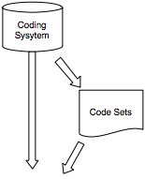

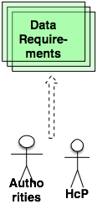
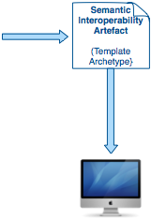


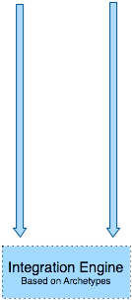
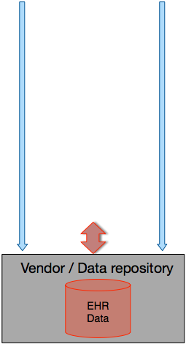
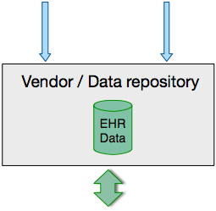
Information Architecture (short term 1)
HSE
Tooling Environment
Dublin, 16 October 2013
© ERS B.V.
Notes:
The picture describes the short term:
Data Requirements from authorities and Healthcare providers
Archetypes/Templates as Semantic Interoperability Artefacts
With inserted/attached relevant codes from coding systems (SNOMED, …)
With Codes and Value sets as defined by the data requirements
A Tooling environment to produce, manage and publish the semantic interoperability artefacts (SIA=archetypes and templates)
Including a Data Dictionary to maintain integrity of the SIA's
HCP and Authorities can see the SIA's and inspect and validate them
Vendors or National/regional registries know what data elements their system has to be able to store, retrieve and present or report because they can get access to computer processable SIA's and the definitions in the Data Dictionary.
When vendors want to transform their proprietary format to one based on SIA's, an agile model driven Integration Engines exists that using SIA's can flexibly transform between EHR-systems.
Systems that have an SIA enabled interface can exchange without the need of an Interface Engine, but they need the SIA’s.
In the example:
- The SIA’s produced by the HSE/ERS Tooling Environment are used by the proprietary EHR-systems.
- The SIA’s express the data/information needs by the Healthcare Providers and Authorities.
- Vendors with proprietary systems will use the SIA’s to make t possible that their proprietary systems can deal with these data points.
- For communication between vendors or Data Registries an Integration Engine can map data between any proprietary format and the normalised standards based format.
- The Integration Engine makes use of the same SIA’s using an agile effective and efficient model based application.

Slide 9
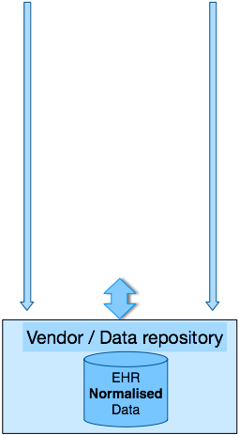
Information Architecture (short term 2)
HSE
Tooling Environment
Dublin, 16 October 2013
© ERS B.V.
Notes:
In the example:
Proprietary data is transformed to an EHR_systems that deals internally with normalised data.

Slide 10
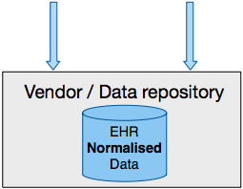

Information Architecture (long term)
HSE
Tooling Environment
Dublin, 16 October 2013
© ERS B.V.
Notes:
This picture describes the long term situation.
When systems are internally based on data standards or provide an standardised interface using the Semantic Interoperability Artefacts
NO Integration Engine is necessary.
Systems can be federated easily.

Slide 11
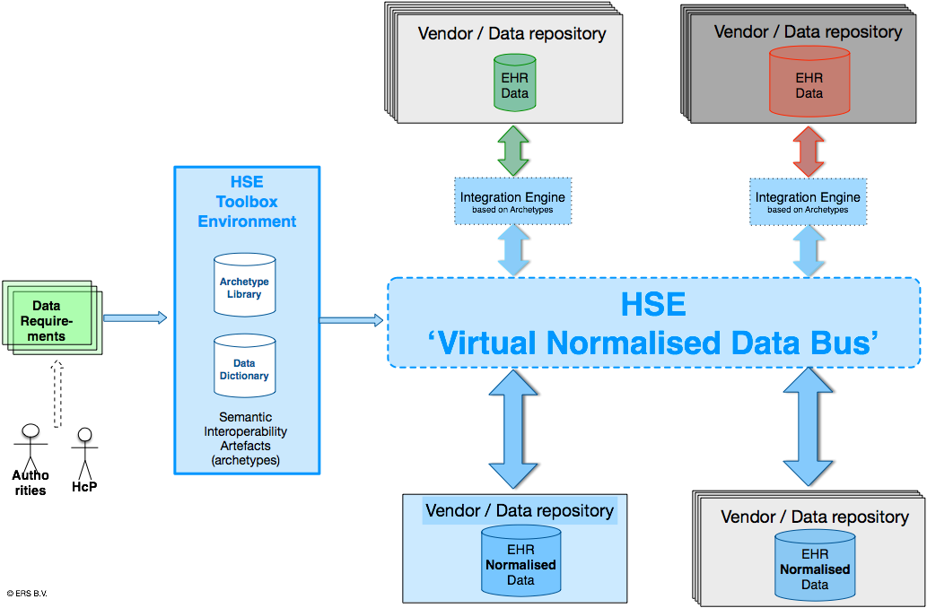
Semantic Interoperability Framework
Dublin, 16 October 2013
© ERS B.V.
Notes:
Data elements, as shared and common basic building blocks, as defined by SIA’s, make possible a HSE ‘Virtual Normalised Data Bus’.
EHR-systems and Data repositories can be functional initialy.
A managed evolutionary process can transform all EHR-systems and Repositories to one using normalised data.
These EHR-systems and Repositories can be federated: exchange any data ad-hoc.

Slide 12
Approach
Embrace a broad stakeholder base
Eight (Small Group) Workshops (4x2)
Use an Interactive basis
Questionnaire type structure
Missed Stakeholders followed up by phone and email
Feedback opportunity
Reach both high level and technical audiences
Dublin, 16 October 2013
Notes:
We have to optimally engage Stakeholders
ERS/HSE execute a project leading to a description and demonstration of a possible ‘HSE Virtual Data Bus; consisting of a standards based HSE/ERS Tooling Environment that produce, maintain, govern and publish Semantic Interoperability Artefacts that make the HSE Virtual Data Bus possible.
It is a path all stakeholders are invited to travel with us.
Their input will be indispensable for a successful journey.
Basic notion of any common and shared infrastructure is:
By all, for all.
Meaning that we all must benefit in the end, in order to create success.

Slide 13
Workshop Dates
28th October: Workshop 1 for Parts 1 and 2
29th October: Workshop 2 for Parts 1 and 2
11th November: Workshop 3 for Parts 1 and 2
12th November: Workshop 4 for Parts 1 and 2
2nd December: Workshop 1 for parts 3 and 4
(Including demo data dictionary)
3rd December: Workshop 2 for parts 3 and 4
(Including demo data dictionary)
16th December: Workshop 3 for parts 3 and 4 (Including demo data dictionary)
17th December: Workshop 4 for parts 3 and 4 (Including demo data dictionary)
Dublin, 16 October 2013

Slide 14
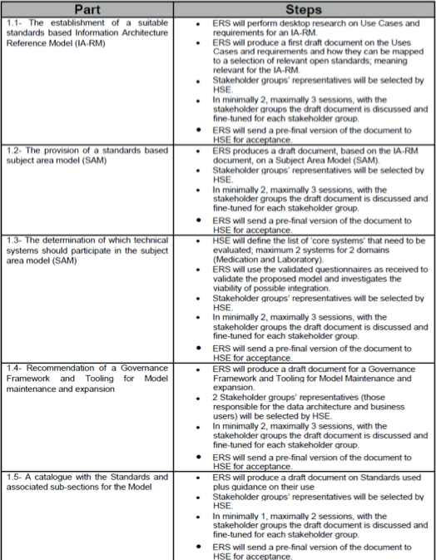
Deliverables
Dublin, 16 October 2013

Slide 15
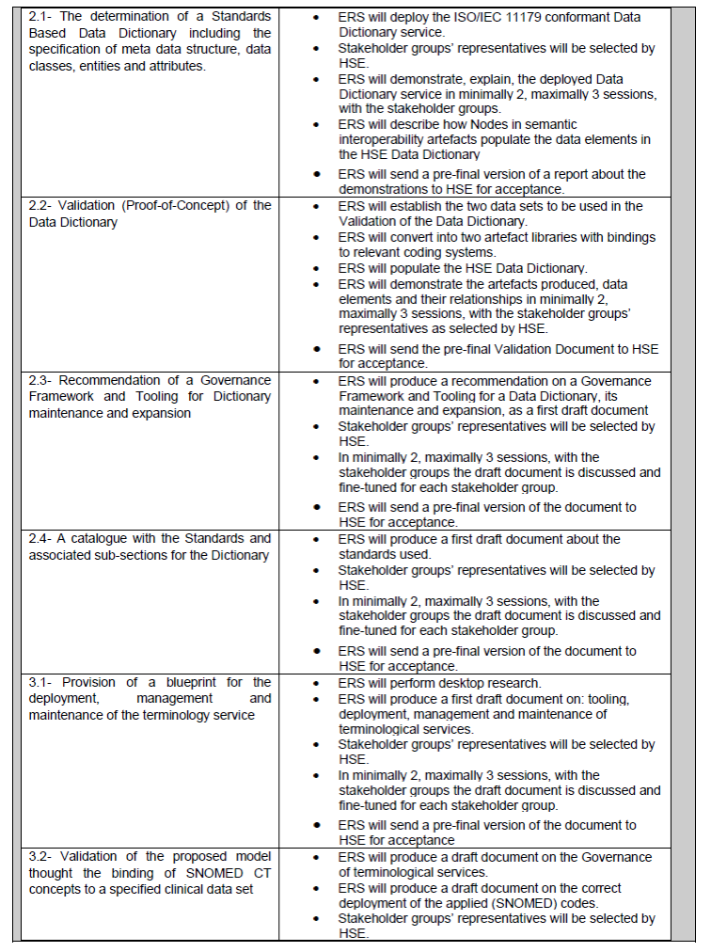
Deliverables
Dublin, 16 October 2013

Slide 16
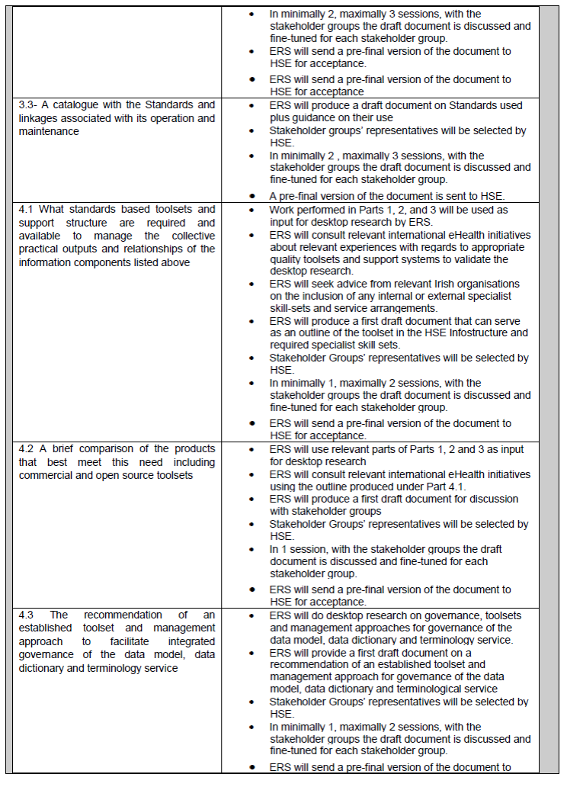
Deliverables
Dublin, 16 October 2013

Slide 17
Roadmap & Timelines
Part-1 Determination of the Information Model | Due Date
The establishment of a suitable standards based Information Architecture Reference Model (IA-RM) | Fri 31/01/2014
The provision of a standards based subject area model (SAM) | Fri 31/01/2014
The determination of which technical systems should participate in the subject area model (SAM) | Fri 31/01/2014
Recommendation of a Governance Framework and Tooling for Model maintenance and expansion | Fri 31/01/2014
A catalogue with the Standards and associated sub-sections for the Model | Fri 31/01/2014
Part-2 Data Dictionary
The determination of a Standards Based Data Dictionary including the specification of meta data structure, data classes, entities and attributes | Fri 31/01/2014
Validation (Proof-of-Concept) of the Data Dictionary | Fri 31/01/2014
Recommendation of a Governance Framework and Tooling for Dictionary maintenance and expansion | Fri 31/01/2014
A catalogue with the Standards and associated sub-sections for the Dictionary | Fri 31/01/2014
Dublin, 16 October 2013

Slide 18
Roadmap & Timelines
Part-3 Terminology Assurance
Provision of a blueprint for the deployment, management and maintenance of the terminology service | Fri 28/03/2014
Validation of the proposed model through the binding of SNOMED CT concepts to a specified clinical data set | Fri 28/03/2014
A catalogue with the Standards and linkages associated with its operation and maintenance | Fri 28/03/2014
Part-4 Support Processes & Services
What standards based toolsets are required to manage the collective practical outputs and relationships of the information components listed above | Fri 28/03/2014
A brief comparison of the commercial and open source products that best meet this need | Fri 28/03/2014
The recommendation of an established toolset and management approach to facilitate integrated governance of the data model, data dictionary and terminology service. | Fri 28/03/2014
Dublin, 16 October 2013

Slide 19
LOT 4 INFORMATION ARCHITECTURE
Part 1: Information Architecture
Part 2: Data Dictionary
Part 3: Terminology
Part 4: Operations (Governance)
Dublin, 16 October 2013

Slide 20
Part 1 - Determination of the Information Model
Establish suitable standards based Information Architecture Reference Model (IA-RM)
The provision of a standards based subject area model (SAM)
The determination of which technical systems should participate in the subject area model (SAM)
Recommendation of a Governance Framework and Tooling for Model maintenance and expansion
A catalogue with the Standards and associated sub-sections for the Model
Dublin, 16 October 2013

Slide 21
Part 2 - Data Dictionary
The determination of a
Standards Based Data Dictionary including the specification of meta data structure, data classes, entities and attributes
Validation (Proof-of-Concept) of the Data Dictionary
Recommendation of a Governance Framework and Tooling for Dictionary maintenance and expansion
A catalogue with the Standards and associated sub-sections for the Dictionary
Dublin, 16 October 2013

Slide 22
Part 3 - Terminology Assurance
Provision of a blueprint for
the deployment, management and maintenance of the terminology service
Validation of the proposed model thought the binding of SNOMED CT concepts to a specified clinical data set
A catalogue with the Standards and linkages associated with its operation and maintenance
Dublin, 16 October 2013

Slide 23
Part 4 - Support Process and Services
What standards based toolsets and
support structure are required and available to manage the collective practical outputs and relationships of the information components listed above
A brief comparison of the products that best meet this need including commercial and open source toolsets
The recommendation of
an established toolset and
management approach to facilitate integrated governance of the data model, data dictionary and terminology service
Dublin, 16 October 2013

Slide 24
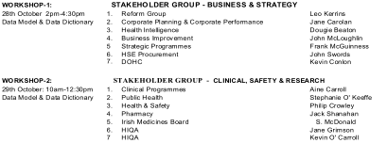
Stakeholders
Dublin, 16 October 2013

Slide 25
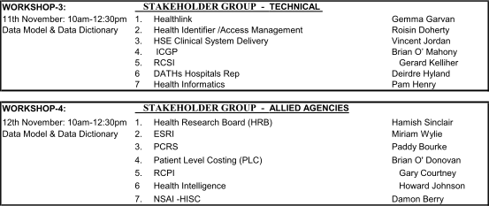
Stakeholders
Dublin, 16 October 2013

Slide 26

Stakeholders
Dublin, 16 October 2013

Slide 27
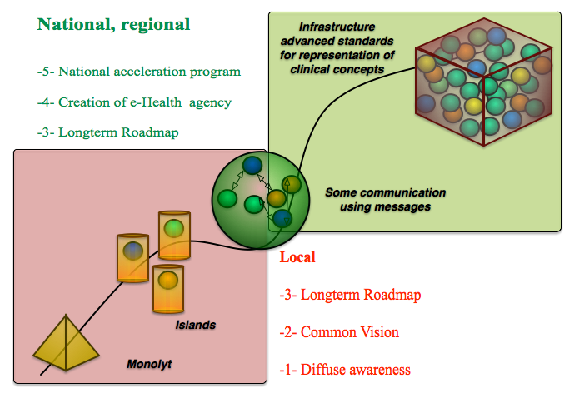
EHR-system developments
A European Perspective on the Cultural and Political Context for Deploying the Electronic Health Record
Authors: Rossi-Mori, Freriks
Dublin, 16 October 2013
© Springer (Ed.: Demitriades, Christopherson, Kolodner)
Person-Centered Health Records: Toward HeathePeople
Notes:
From Monolyt to Standards Based (National / European) Data Bus
via Silo’s, Best of Breeds, and Messaging systems.
This transition to the next level is:
- a technical manageable challenge
- but foremost a political, psychological and economical challenge
- And finally it is a long term never ending transition process.
It is the complex trajectory of instituting a new governed large scale infrastructure for semantic interoperability in health and social care.
Important aspects of this Roadmap are discussed in the next slide

Slide 28








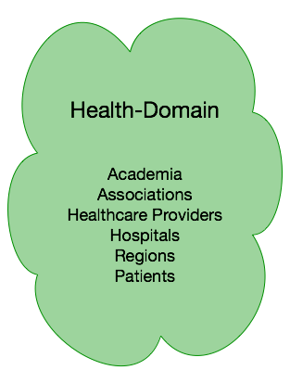
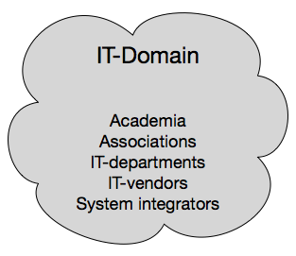
Important aspects of any Roadmap
Procurement
Dublin, 16 October 2013
Notes:
Important aspects of any Roadmap.
What will be created is a Governance structure for a continuing process and NOT one or more projects.
1- Government: initiates: Policies, Rules and Regulations securing quality of healthcare , health outcomes and quality of IT-systems
2- National: project operationalises
3- Compliance with the rules and regulations entails conformance to a set of standards for aspects: IT-technology, Semantic Interoperability, Coding systems, shared Clinical Models, Functional requirements
4- A framework for quality assurance, qualification cq certification used for Procurement of Health and Care IT-systems
5- A set of tailored incentives (remunerations, fines, training, support) for actors in the Health (knowledge) domain and IT (Knowledge) domain. Health and Care payors play a role
6- A body with ‘champions’, with authority, to advice all actors to take the correct steps at the correct moments in time.
Remarks:
- Each actor must operate in its Natural Role
- ‘Directors’ must use authority and convincing argument to execute their role and preferably do NOT fund projects and processes.

Slide 29

Journey together to the common INFOstructure
Dublin, 16 October 2013
© Paul Horton
Notes:
We, HSE and ERS, take you, stakeholders, on an exciting journey..
Will we find fulfillment in the inviting and not to be missed house with the burning stove?
Or is it behind the hill?
We, ERS, have a vision of the travel plan and the supporting standards based technology.
we now some potential pitfalls we will encounter,
we now some dead-end streets, we should not take.
We can be successful only when we travel all together.
We all have to be willing to be taught, and discuss benefits and barriers, to learn from each other.
We are talking about a standards based infrastructure for semantic interoperability, for co-operability, in health nad socials care.
We are talking about a common and shared INFOSTRUCTURE.
By all, for all.

